Slide 1
March 27, 2018
On Page Factors
Notes:
Show of Hands

Slide 2
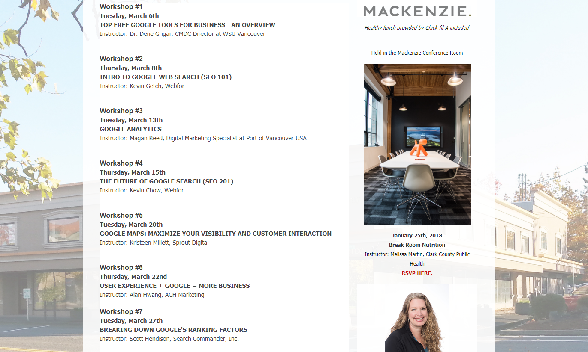
Notes:
Wo saw all of these presentations?

Slide 3
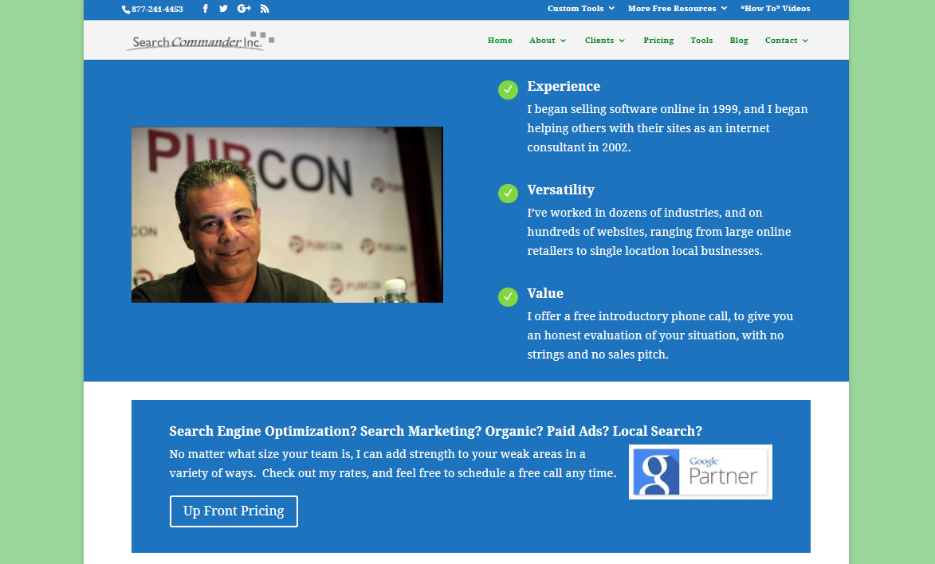
ABOUT ME
Scott Hendison

Slide 4
Breaking Down Google’s Algorithm
Notes:
Tall order

Slide 5
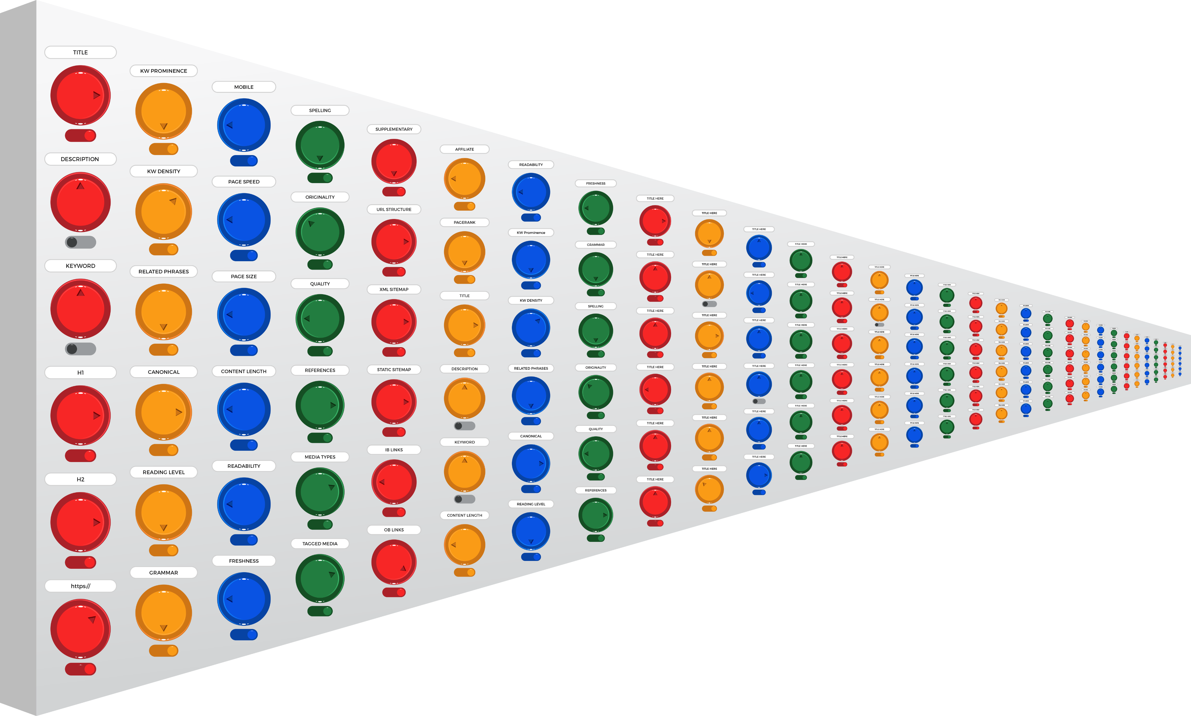
Notes:
Here’s how I like to picture the algorithm at Google
There are 200+ ranking factors
The strength and magnitude of each can vary, including being turned off entirely
For example, the meta keyword tag and description tag used to matter, but now they don’t.

Slide 6
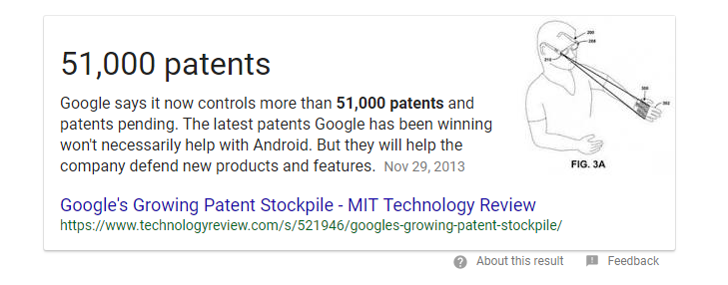
Explaining Google’s Algorithm
Notes:
Tall order, and we can’t possibly cover them all

Slide 7
Many may NEVER be used
Notes:
And many of the patents are only there to help defend their intellectual property.
Others are just ideas that may never come to fruition.

Slide 8
How Does Google Work?
Notes:
Before we look at the algorithms, lats take a look at how Google works

Slide 9
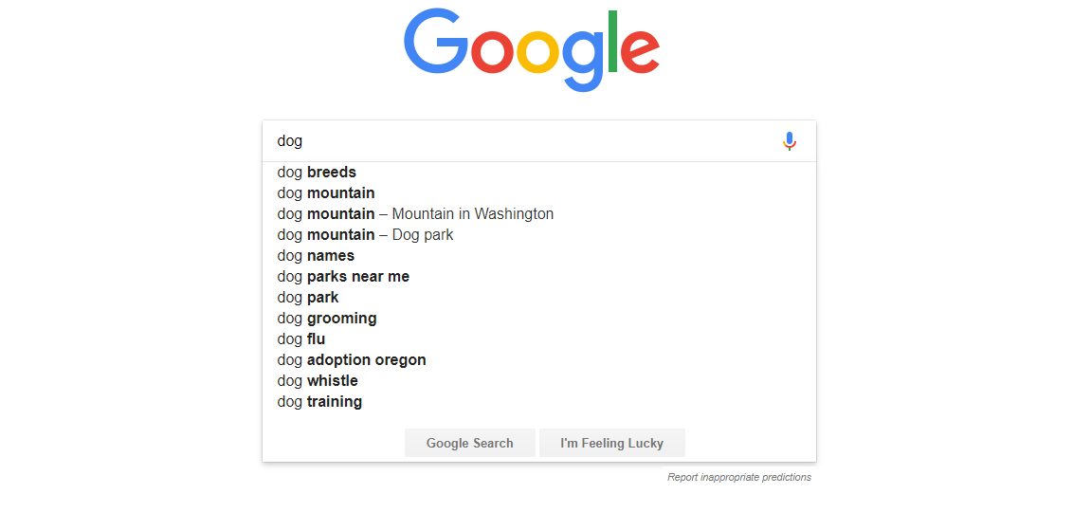
Transactional Searches
Notes:
dog

Slide 10
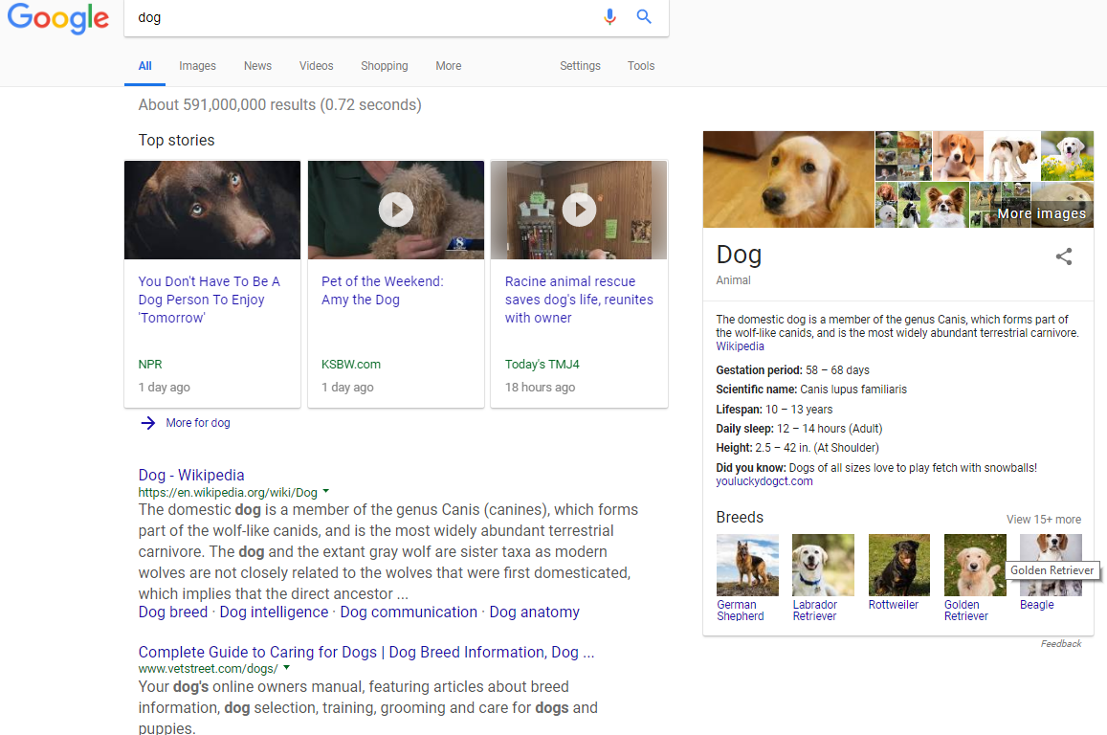
Transactional Searches

Slide 11
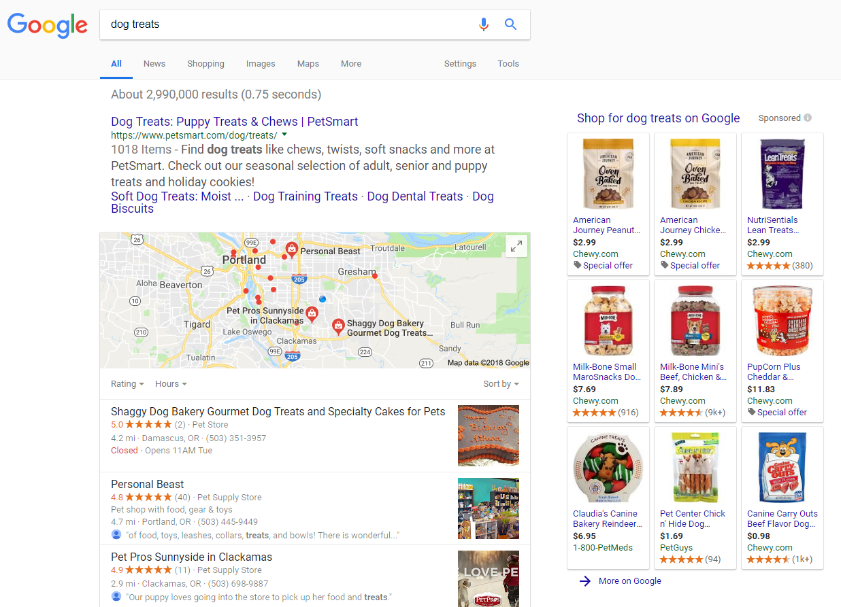
Transactional Searches

Slide 12
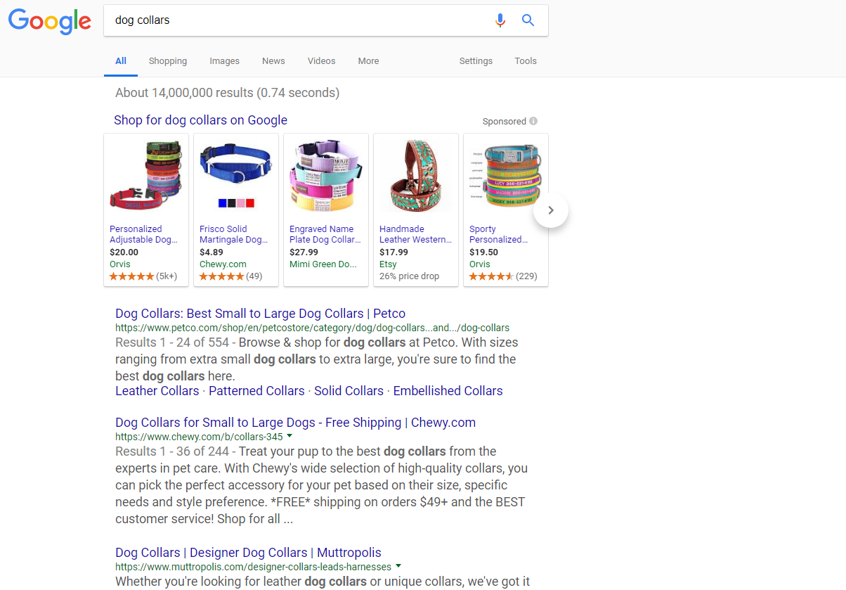
Transactional Searches

Slide 13
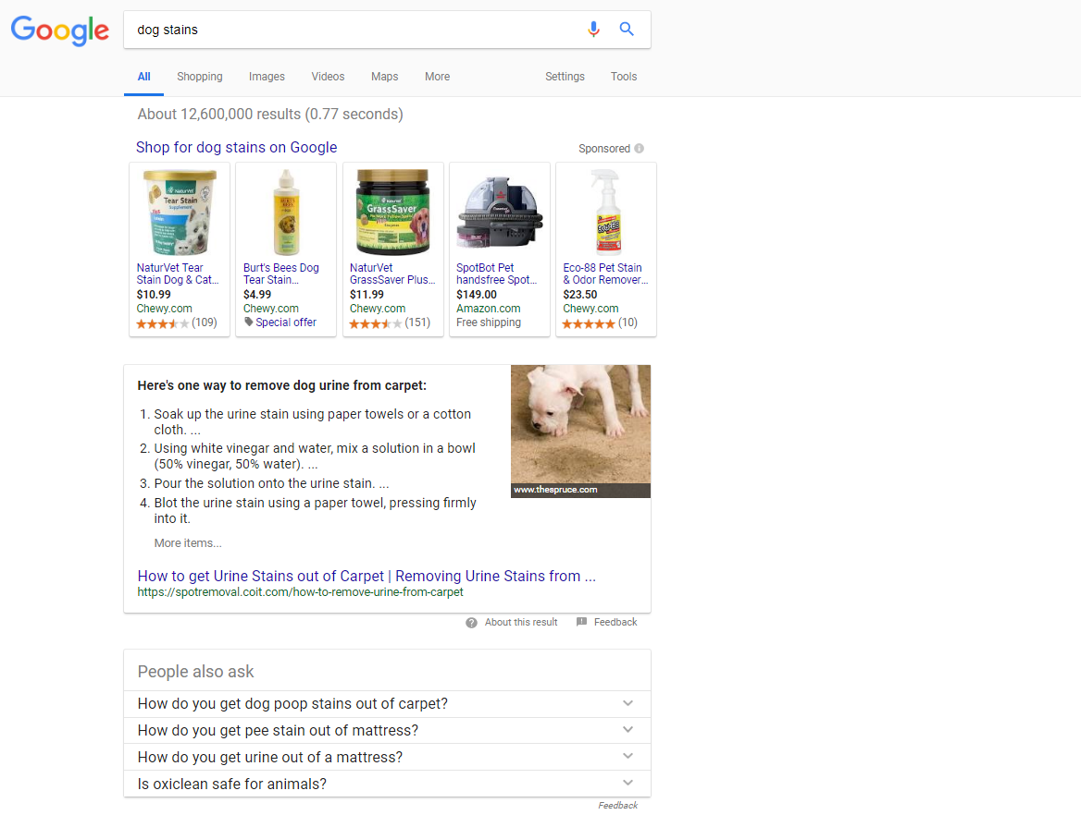
Transactional Searches

Slide 14
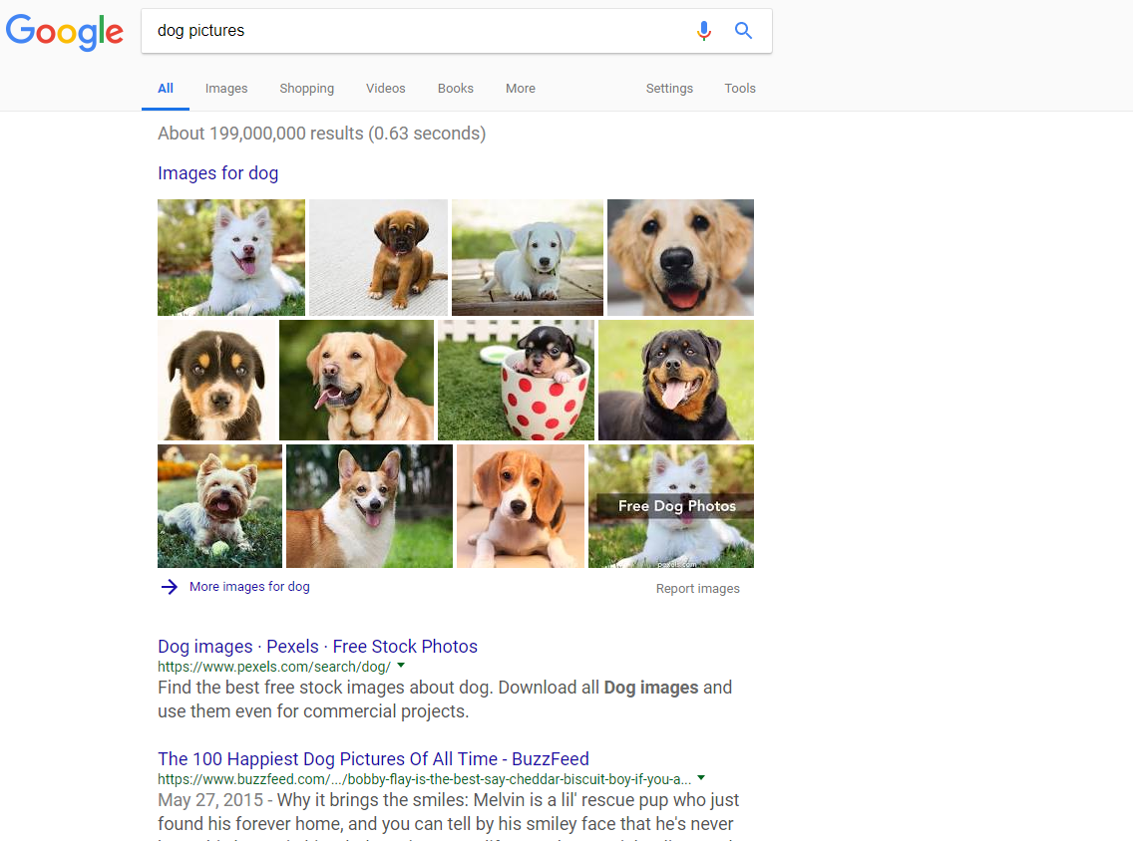
Transactional Searches

Slide 15
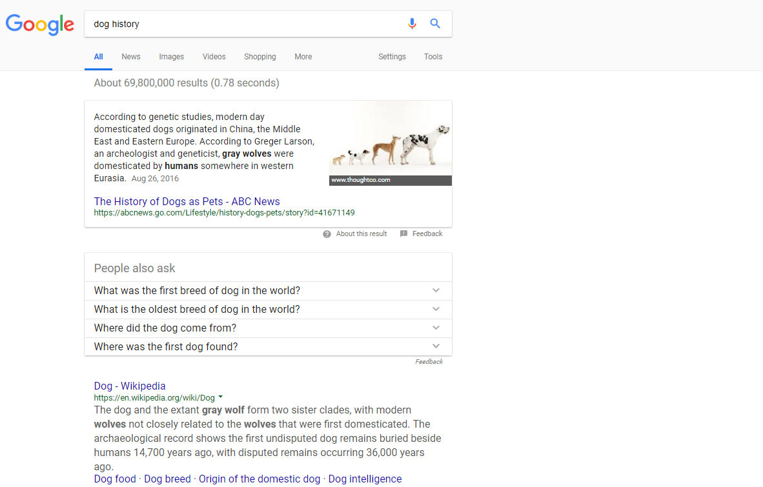
Transactional Searches
Notes:
Answer Box – An enhanced #1 listing that MAY end up hurting more than helping.

Slide 16
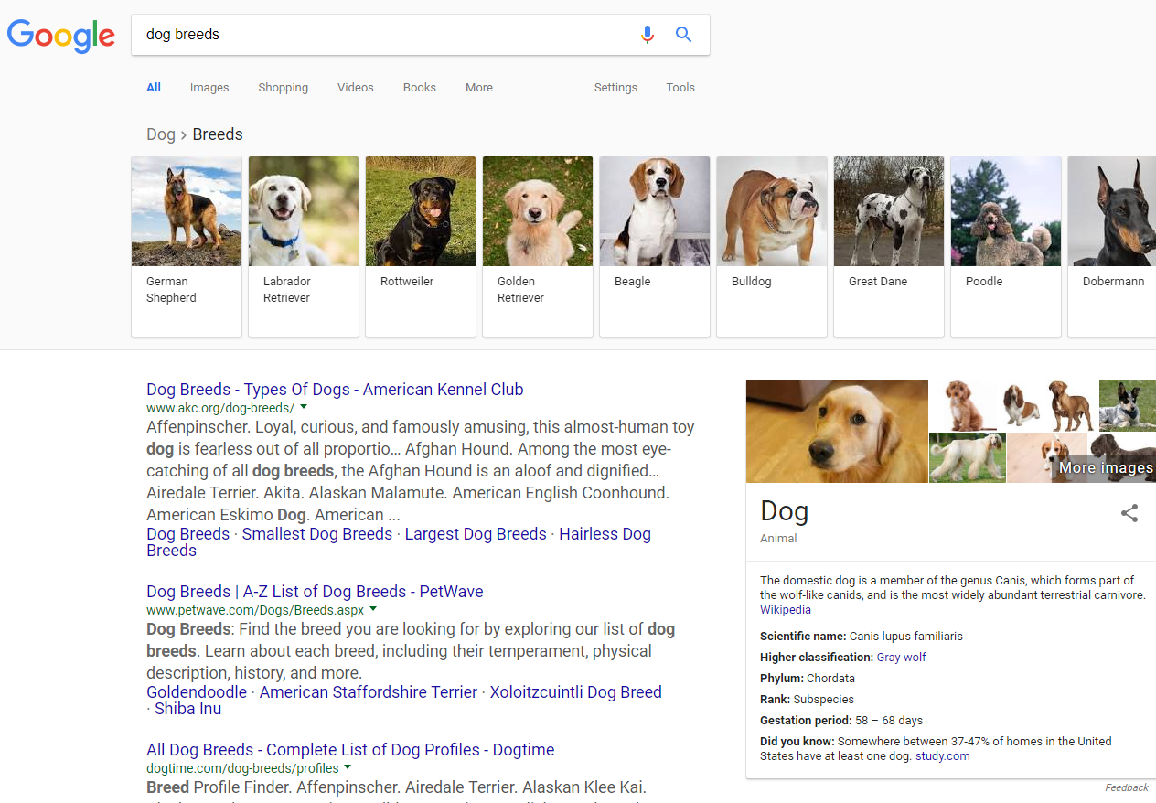
Transactional Searches
Notes:
Each of those images comes from different places, and they all just lead to more search results

Slide 17
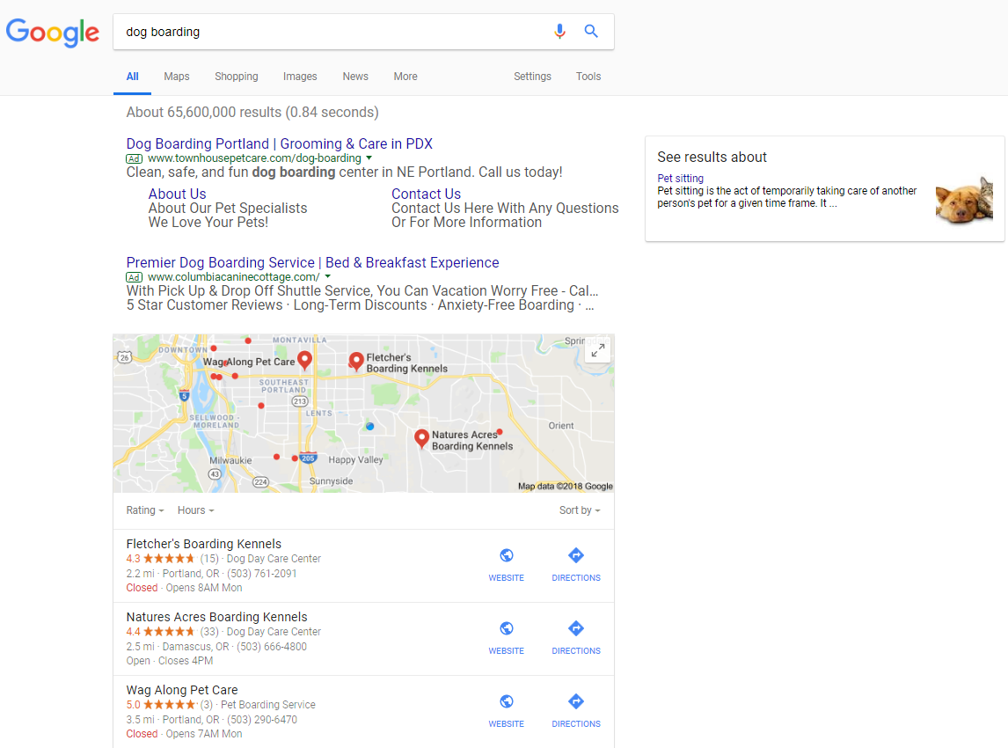
Transactional Searches

Slide 18
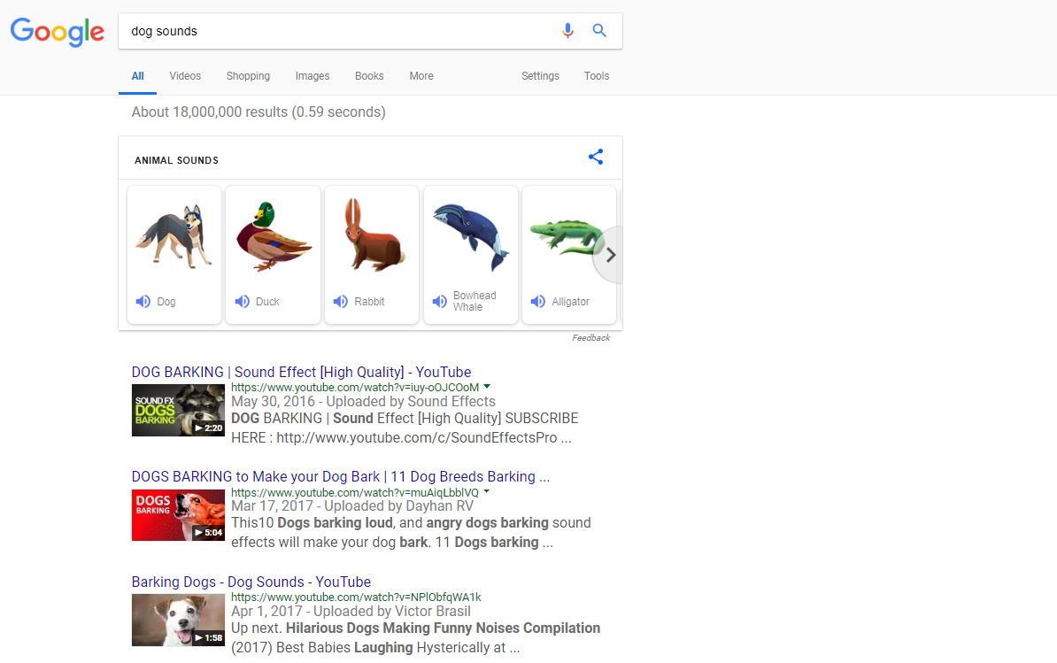
Transactional Searches

Slide 19
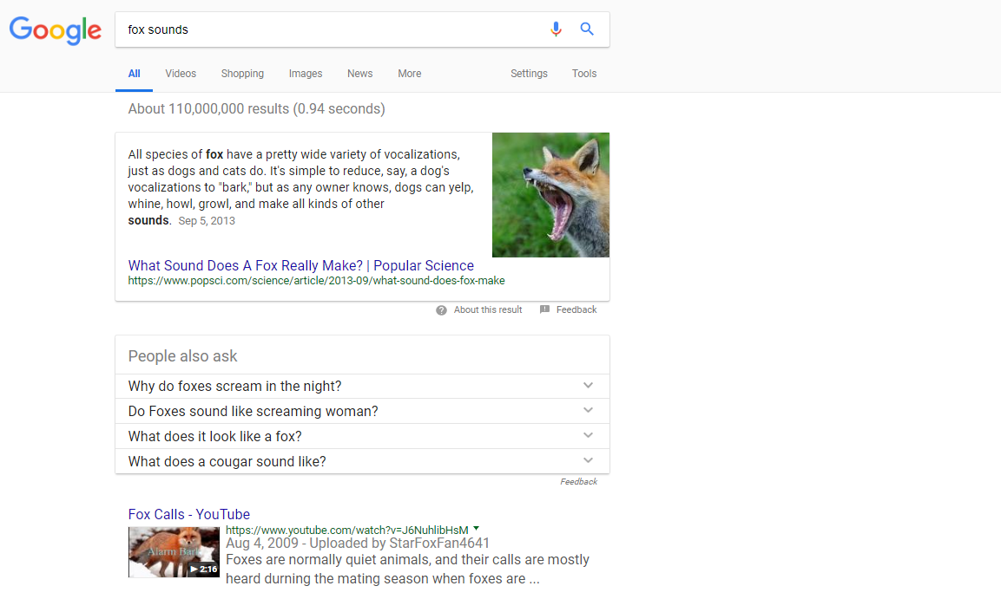
Transactional Searches

Slide 20
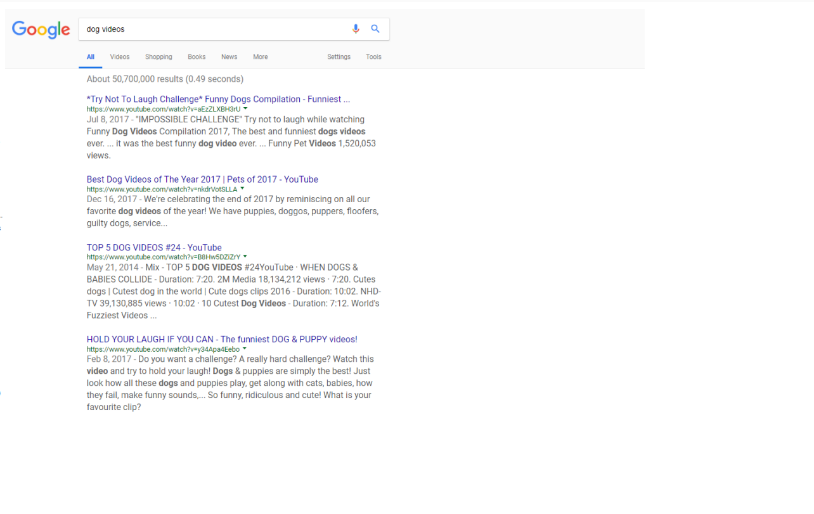
Transactional Searches
Notes:
Most curious – no videos are showing

Slide 21
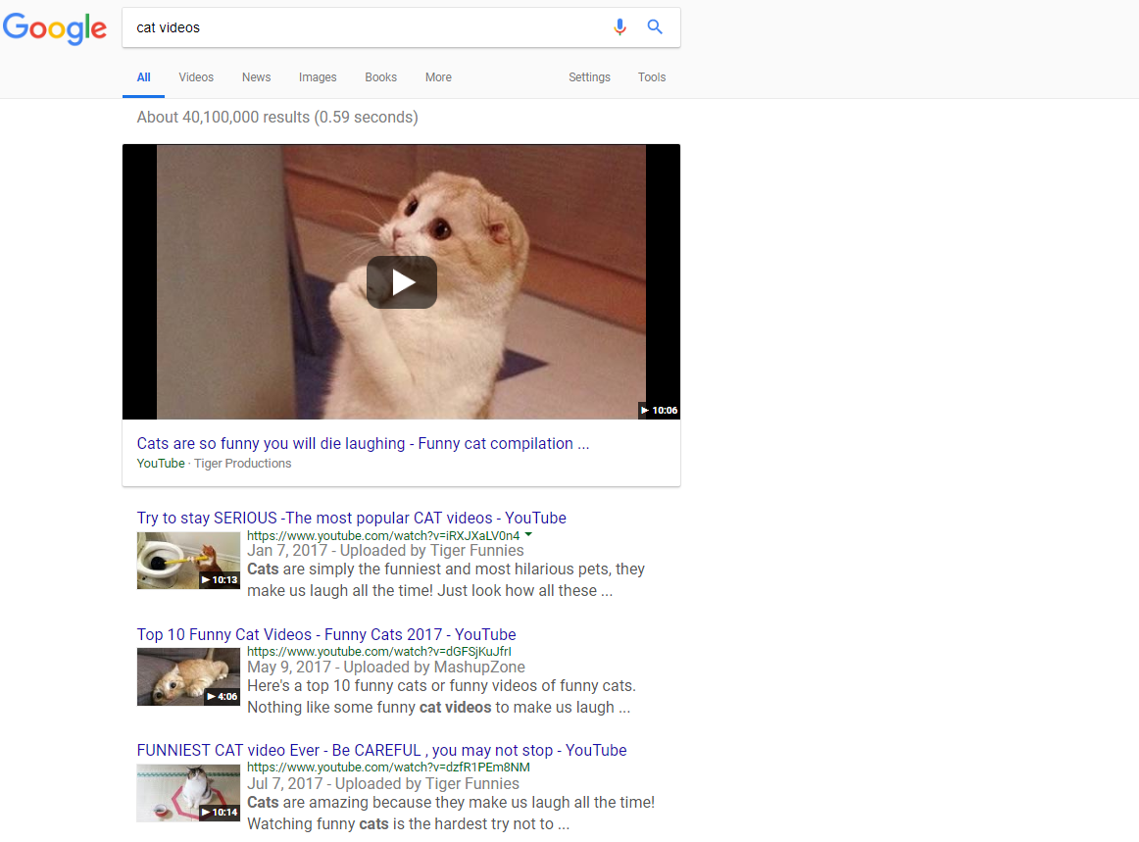
Transactional Searches
Notes:
Clearly species discrimination

Slide 22
What is Google’s Goal?

Slide 23
Google wants to give you what you want.

Slide 24
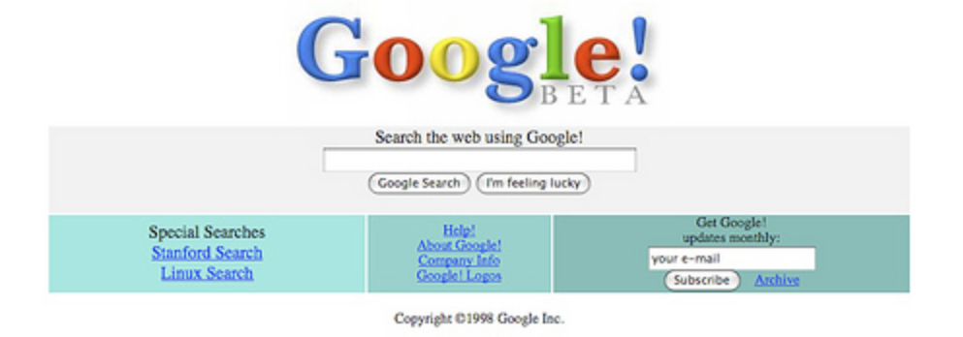
1998
1998 – Page Rank Algorithm
Notes:
Google began in 1998 with the "Page Rank" algorithm.

Slide 25
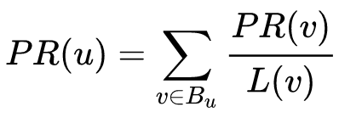
WWGD?
Page Rank Algorithm
Notes:
Page rank was calculated through a mathmatical formula as a score from 0 to 10.
Google even released a toolbar for IE that showed a green bar, and it became anyone cared about.

Slide 26
Vote
Page Rank Algorithm
Notes:
Simple concept - PageRank is measured by links
A link is a “vote” by other pages on the Web, about how important a page is.
A link to a page counts as a vote of support, and more links make a page more important.
Links from more important pages are more valueable.

Slide 27
Go here to buy blue widgets
Page Rank Algorithm
Notes:
Topical relevance was determined by the anchor text.
Over the years that’s expanded to the surrounding text also
A link to a site for blue widgets was more relevant than one from a site about shoes.

Slide 28
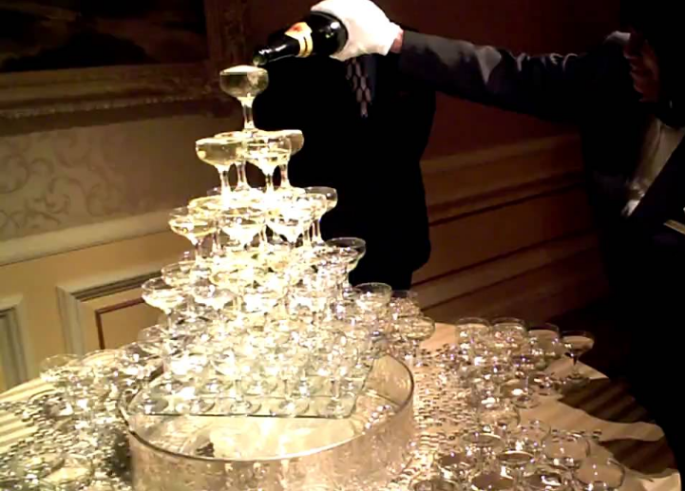
Vote
Page Rank Algorithm
Notes:
“Link Juice” was a term used to describe the flowing equity from one page to another.
Each link to another page sends some of the hosting pages “link juice” to the page it linked to.
Again, the more link juice (equity) a page has, the more it can pass along.
Too many outbound links can bleed of your own link equity.

Slide 29
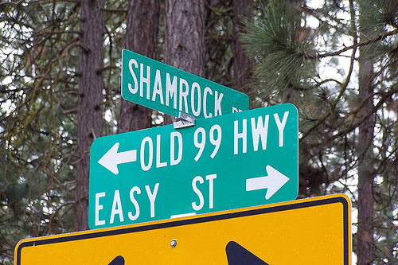
Easy Street
1998 - 2004
Notes:
Slight algorithm updates happened all the time, and until July of 2003, Google would only update their index monthly, rolling it out slowly to all their data centers.
people used to wait for the "Google Dance" to see how their site ranked.

Slide 30
Google Barely Changed
1998 - 2004
Notes:
This is how so many garbage websites and worthless crap ended up on the internet.

Slide 31
Sneaky
1998 - 2004
Notes:
Over the years, people used every trick under the sun to get links, because that's really all that mattered.

Slide 32
Cottage Industry
1998 - 2004
Notes:
Article directories and link networks sprang up, as Google created a cottage industry that still exists today.
Duplicate content didn't matter – anyone could publish anything, and they did.

Slide 33
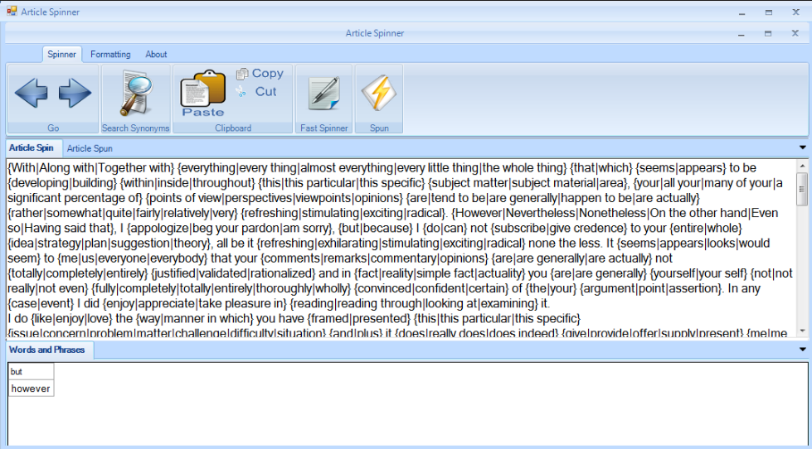
Spinning Content
1998 - 2004
Notes:
Once it did, out came "spinning" software.
Remember when you would just rewrite encyclopedia articles in your own words?
People would create dozens or even hundreds of pages and articles, and submit those to article directories.

Slide 34
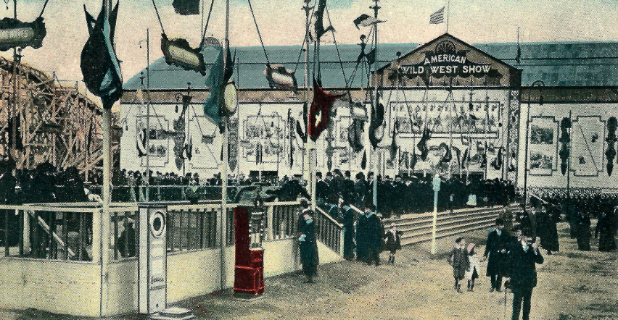
Wild Wild West
1998 - 2004
Notes:
You could use those pages to link to other websites, and build a nice little empire, but something had to change.

Slide 35
Google went public
1998 - 2004
Notes:
In 2004 Google was going public, and they had to get serious about their algorithm updates.
They also implemented a Quality Rater program which today is 160 pages.
For the next 14 years, they've been trying to ensure quality is what ranks.

Slide 36
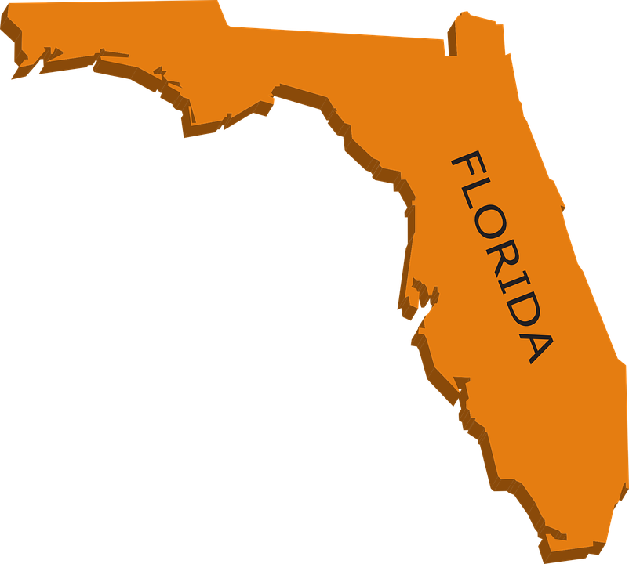
2003 – Florida Update
Notes:
in November 2003 came the first major algorithm shift, called the Florida update.
This was the beginning of the end for low-value sneaky late tactics but it’s been a slow death.
The worst of the worst disappeared entirely from the web, and it caused quite a shakeup.

Slide 37
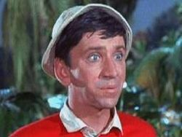
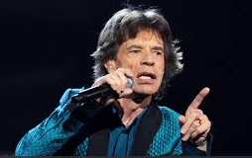
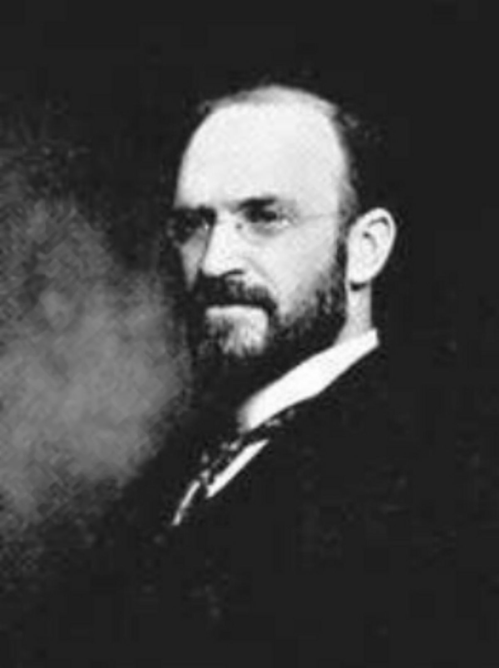
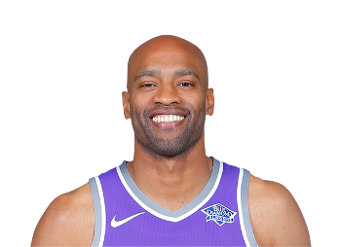
2004 - 2010
Notes:
Over the next few years, there were lots of ranking shakeups and shuffles with lots and lots of algorithm updates.
The larger more dramatic ones were given names, often by Google employees
Gilligan, Jagger, Big Daddy, Buffy, Dewey, and Vince were the biggest, but there were dozens of other small tweaks

Slide 38
2005 - ongoing
Personalization Algorithm
Notes:
Most significant to me, was the increase in personalization that began in 2005.
Computer search history - geographic location, logged in or out – what device you’re using and what Google thinks you’re looking for
This has evolved over the years, and it all means that no two users would often get the exact same results.

Slide 39
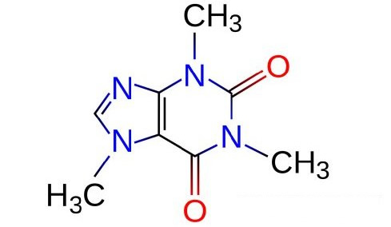
2010 - Caffeine
Notes:
Not an algorithm change –
complete rebuild of their indexing system.
50% fresher results
Google billed it as "the largest collection of web content they've offered".
Instead of a rolling monthly update across google data centers, pages could be crawled and indexed in seconds.
Sites that covered new stories quickly were rewarded.

Slide 40
ANGRY PANDA
2011 – Panda Algorithm
Notes:
2011 was a busy year – Over 20 announced updates, with the most important being various versions of an algorithm called Panda.
Panda was aimed at "low-quality sites" or "thin sites", "content farms“ and it’s had multiple updates over the years.
“Don’t write content just for the sake of content”

Slide 41
PENGUIN
April 24, 2012 - Penguin
Notes:
April 2012 Google Penguin attempted (and succeeded) to catch sites deemed to be spamming its search results by buying links or obtaining them through link networks designed primarily to boost Google rankings.

Slide 42
PENGUIN
April 24, 2012 - Penguin
Notes:
Some sites including my own lost 90% of their traffic

Slide 43
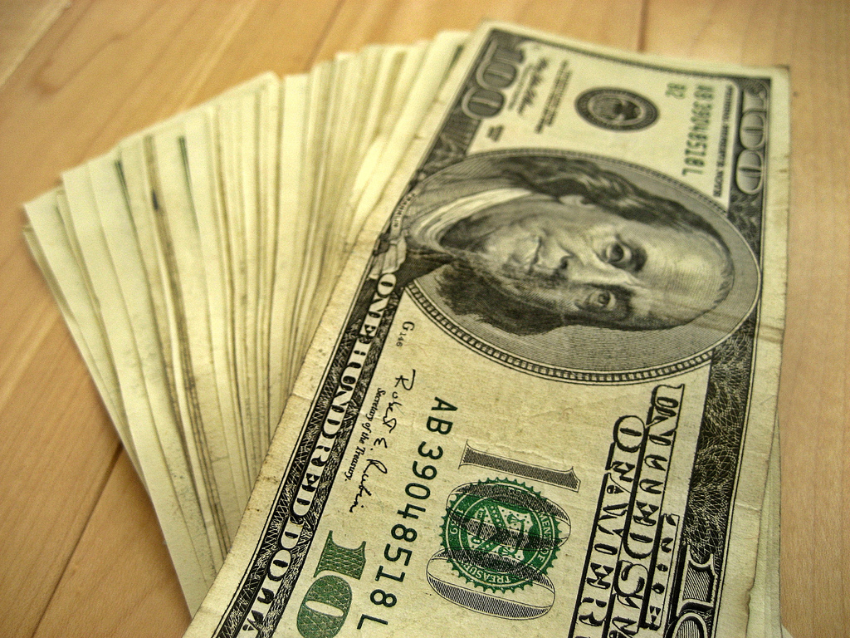
Payday Loan
2013 – Payday Loan Algorithm
Notes:
June 2013 - The "Payday Loan" algorithm was targeted at super competitive and spammy industries.
It affected as much as 4% of all search queries,
Payday loans, casinos, debt consolidation sites, pharmaceuticals all got hit.
Legitimate areas too like mortgages and insurance were also affected.

Slide 44
HUMMINGBIRD
2013 – Hummingbird – Not an Algo
Notes:
"Hummingbird" was the first true / major update to Google's search algorithm since the 2010 "Caffeine" search architecture upgrade
It included not only better indexing, but better sorting of that information.

Slide 45
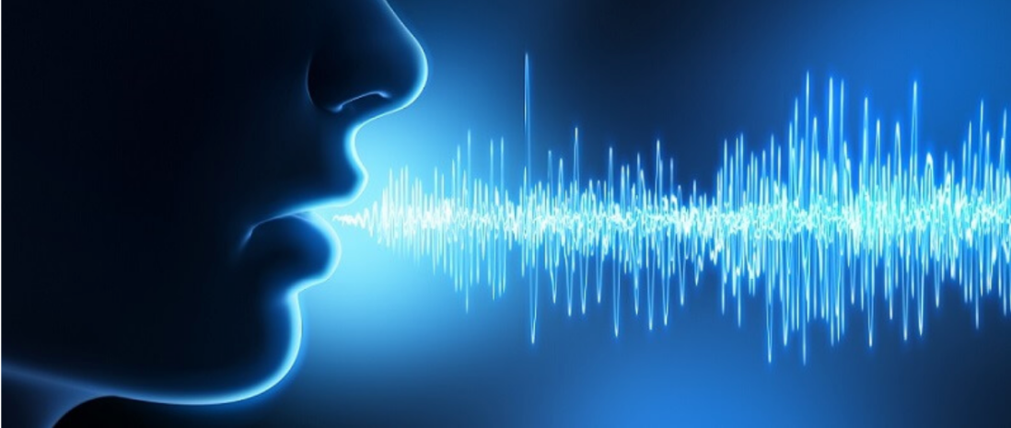
HUMMINGBIRD
2013 - Hummingbird Algorithm
Notes:
"Hummingbird" greater emphasis on natural language queries
Context and meaning over individual keywords.
Web developers and writers needed to use natural writing rather than forced keywords,
to get google to understand what the page was about.
Pages full of stuffed keyowrds dropped like a rock.
This was a good thing.

Slide 46
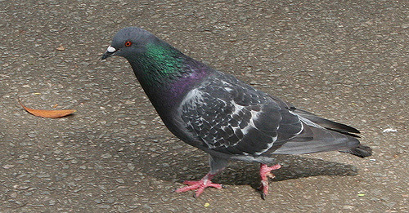
Pigeon
2014 – Pigeon Algorithm
Notes:
July 2014 – The Pigeon algorithm affected the rankings of local listing in a search –
Google claimed to be trying to bring more organic ranking signals into the local algorithm,

Slide 47
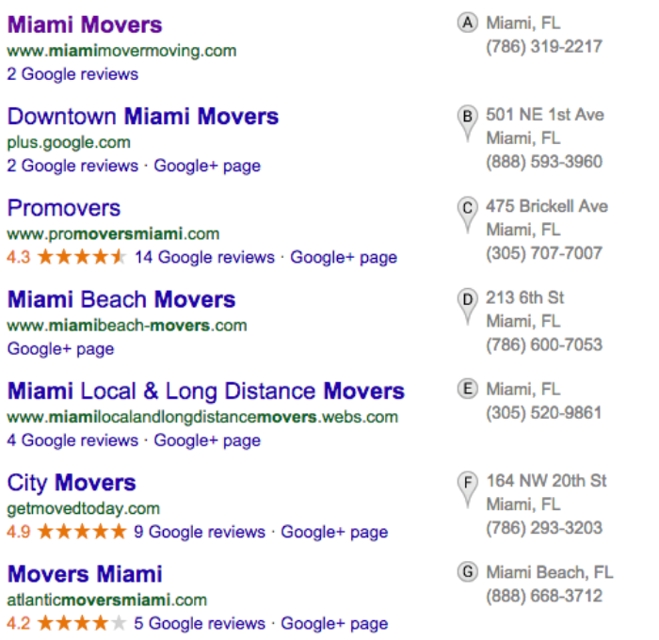
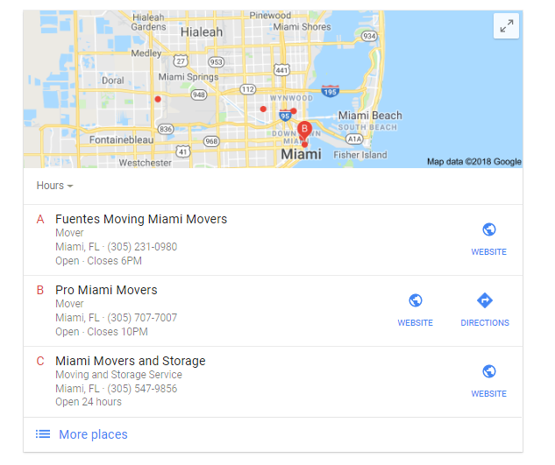
2014 – Pigeon Algorithm
Notes:
Map boundaries were redrawn to a much narrower radius.
Instead of showing 7 Maps rankings on page one, they went to just three.
A lot of local businesses got hurt with this algorithm change.

Slide 48
Mobilegeddon
April 2015 – Mobile Friendly Algo
Notes:
In 2014 Google pre-announced an algorithm update, coming April 22 2015 - Mobilegeddon

Slide 49
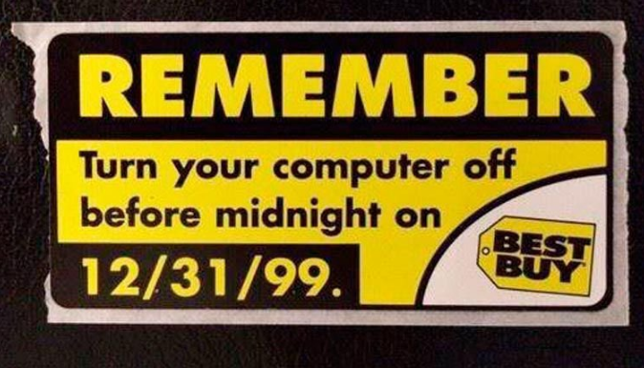
Mobilegeddon
Nothing happened
Notes:
We all warned clients that sites that weren’t mobile friendly could disappear from the search results altogether –
It didn't happen, but it's happening now with the mobile first index.

Slide 50
Rankbrain
2015 – Rankbrain Algorithm
Notes:
2015 RankBrain became part of Google’s overall search algorithm.
Google began using artificial intelligence to sort through pages and find the ones deemed most relevant for any given query.

Slide 51
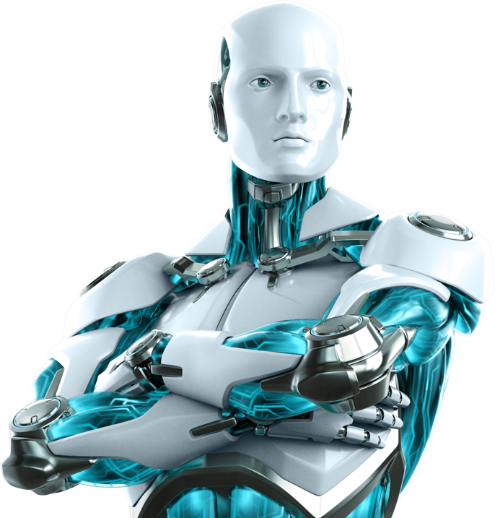
2015 – Rankbrain Algorithm
Notes:
To me – instead of a pre programmed algorithm turning the dials we now have AI making MANY of the decisions
Not all though, and human reviewers as well as manual penalties are still a thing.

Slide 52
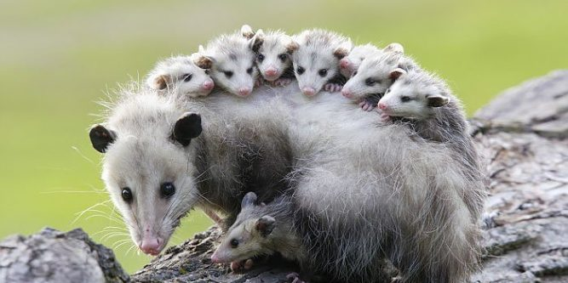
POSSUM
2016 – Possum Algorithm
Notes:
Possum impacted ranking in the local pack. Intent was to diversify the local results and prevent spam from ranking as well.
Lawyers or Medical offices with multiple practitioners listed with GMB pages could no longer dominate
See, they don't WANT people seeing the same results when they're looking for something local.

Slide 53
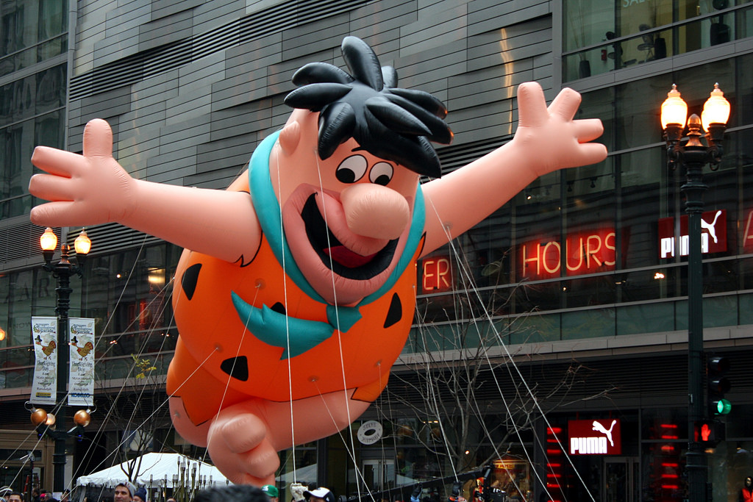
Fred
2017 – Fred Algorithm
Notes:
March 8, 2017 "Fred" was an update that (supposedly) hit low-value content sites that focus on revenue instead of users.
Fred primarily affected low-quality, ad-heavy sites with thin content and bad backlinks

Slide 54
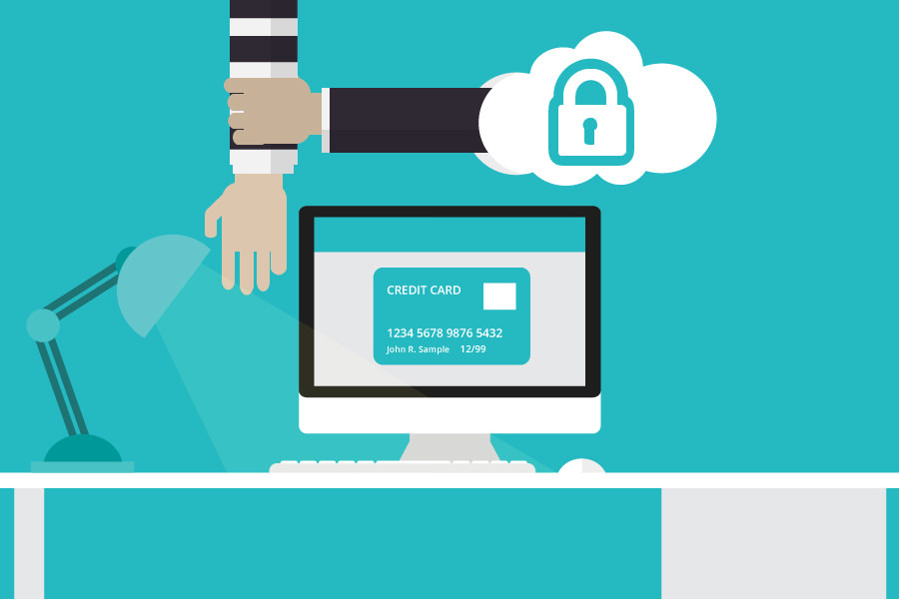
SSL
2017 – Security Warnings
Notes:
Again, not an “algorithm”, but in October of 2017 Chrome began showing users HTTPS Warnings.
Any time there's a form on a page that's insecure, once someone starts typing, they'll see a warning by the address bar. .

Slide 55
SSL
2017 - Security Warnings
Notes:
In July, that warning will begin appearing for everyone even for pages with no form.

Slide 56
SSL
2017 - Security Warnings
Notes:
Expect the other browsers to follow, and don't be surprised if that warning goes to red by the end of the year

Slide 57
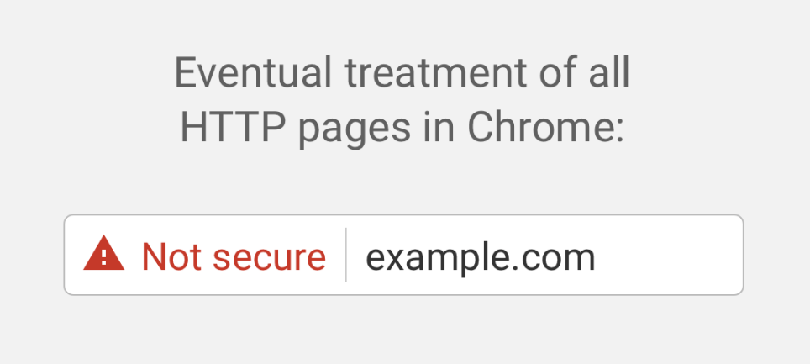
SSL
2017 - Security Warnings
Notes:
The Googles page about the topic shows this – with “not secure” in red

Slide 58
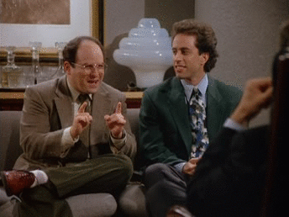
SSL
2018 – Nothing… yet

Slide 59
All Algorithm Updates have one thing in common…
Notes:
All of these updates were designed to do one thing - Give you, the searcher, what you were looking for, close to the top of the page

Slide 60
What is Google’s Goal?

Slide 61
Google’s Goal is to give you exactly what you are looking for

Slide 62
Your goal should be the same for your visitors.

Slide 63
What Should You Focus On?
Notes:
Google has (apparently) caught onto people that create — and quickly remove — spammy links. Also know as a temporary link scheme.

Slide 64
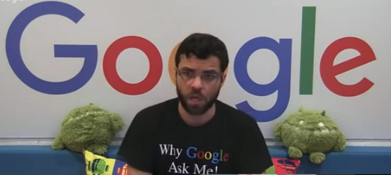
What Should You Focus On?
Notes:
Google has (apparently) caught onto people that create — and quickly remove — spammy links. Also know as a temporary link scheme.

Slide 65
1. User Experience
Notes:
Go through your own website on a computer and on a phone
Try the forms, try click to call, check your menus.
Put yourself in your users shoes

Slide 66
1. User Experience 2. Speed & Performance
Notes:
One day I predicted speed would be a factor and the next day, Google’s Matt Cutts announced it.
Nothing is more frustrating than a slow website.
Don’t use unedited (giant) cell phone images
File size is not the same as a file dimensions
Google has tools, and others are better.

Slide 67
1. User Experience 2. Speed & Performance 3. Give users what they want
Notes:
Answer users questions
Use a site like Quora to research what those are
Check your emails for what is often GREAT content and explanations
Put that content on your site

Slide 68
1. User Experience 2. Speed & Performance 3. Give users what they want 4. Write for visitors, not for Google
Notes:
People scan before they read
Leave lots of white space
Use bullet points
Use sub headlines
Wrote to a high school reading level

Slide 69
1. User Experience 2. Speed & Performance 3. Give users what they want 4. Write for visitors, not for Google 5. Security
Notes:
Make sure you’re https:
Make sure you have a green lock next to your address bar
Don’t embed content or iframes from other sites that are not secure

Slide 70
What Are Your Action Steps?
Notes:
Google has (apparently) caught onto people that create — and quickly remove — spammy links. Also know as a temporary link scheme.

Slide 71
1. Get a Google Account 2. Get Google Analytics 3. Get Google Search Console 4. Get Google My Business 5. Get the other presentations

Slide 72
Resources
Google Analytics
Google Search Console
Google My Business
Google SEO Starter Guide
Google Quality Rater Guidelines
Website Speed Tests
SEMrush Suite of Tools
This Presentation – http://bit.ly/scott32718
My website & contact info
Notes:
Google has (apparently) caught onto people that create — and quickly remove — spammy links. Also know as a temporary link scheme.

Slide 73
Resources
Google Analytics
Google Search Console
Google My Business
Google SEO Starter Guide
Google Quality Rater Guidelines
Website Speed Tests
SEMrush Suite of Tools
This Presentation – http://bit.ly/scott32718
My website & contact info
Notes:
Google has (apparently) caught onto people that create — and quickly remove — spammy links. Also know as a temporary link scheme.

